Slide 1
Student System Y’all
Dara Rancifer, Akash Sharma
Richard Zheng, Omar Laymoun

Slide 2
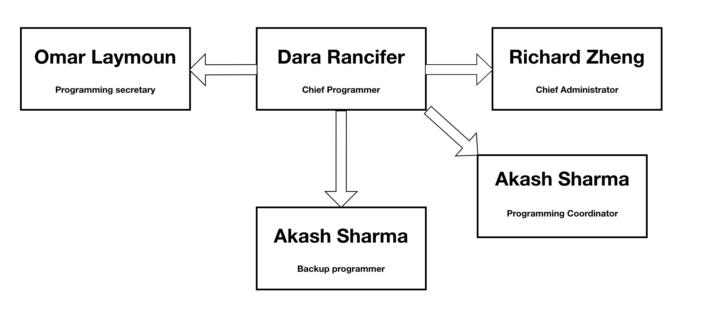

Team Organization
Chief Programmer Model
Chief Programmer – Dara Rancifer
Programming Coordinator – Akash Sharma
Programming Secretary – Omar Laymoun
Back – Up Programmer & Coordinator – Richard Zheng
Back-up Coordinator

Slide 3
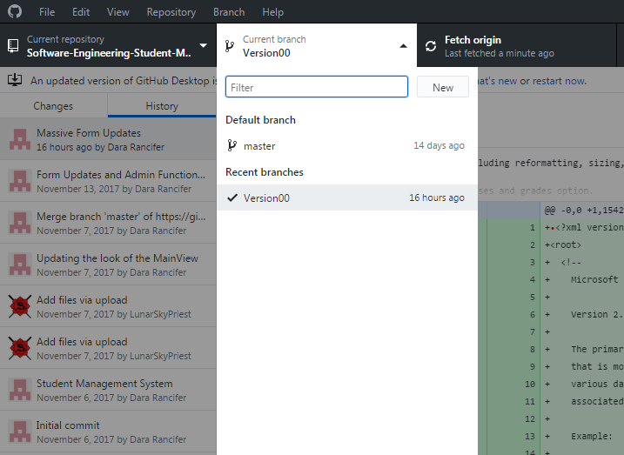
GitHub Demo

Slide 4
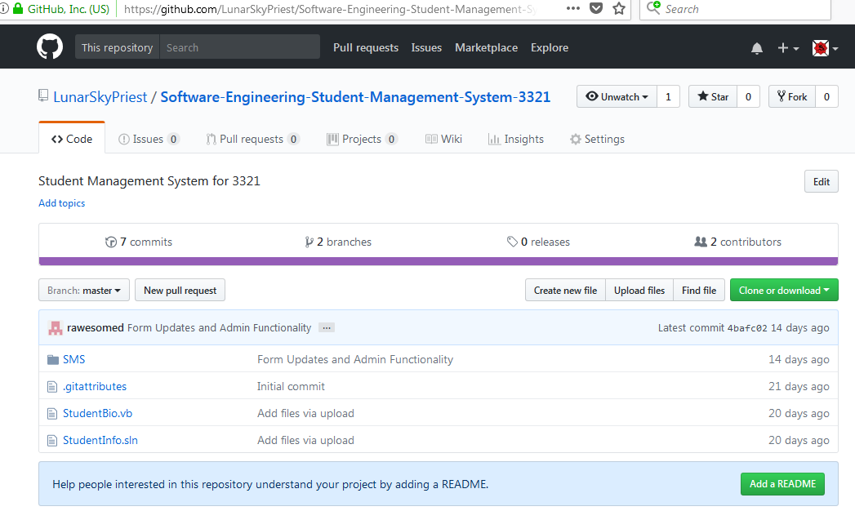
GitHub Demo

Slide 5
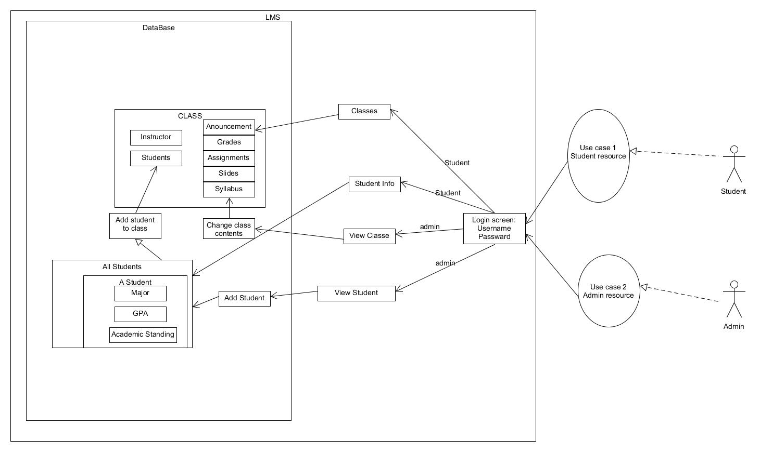
Requirement and Analysis
Admin and Student log ins
Only Admin can add/delete student, courses, grades
Student can only view student info, their courses and grades, and calculate GPA
Functionality similar to Blackboard

Slide 6
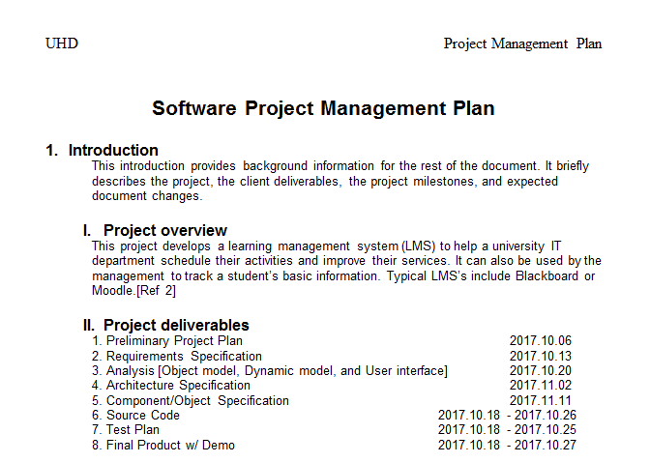
Software Project Management Plan

Slide 7
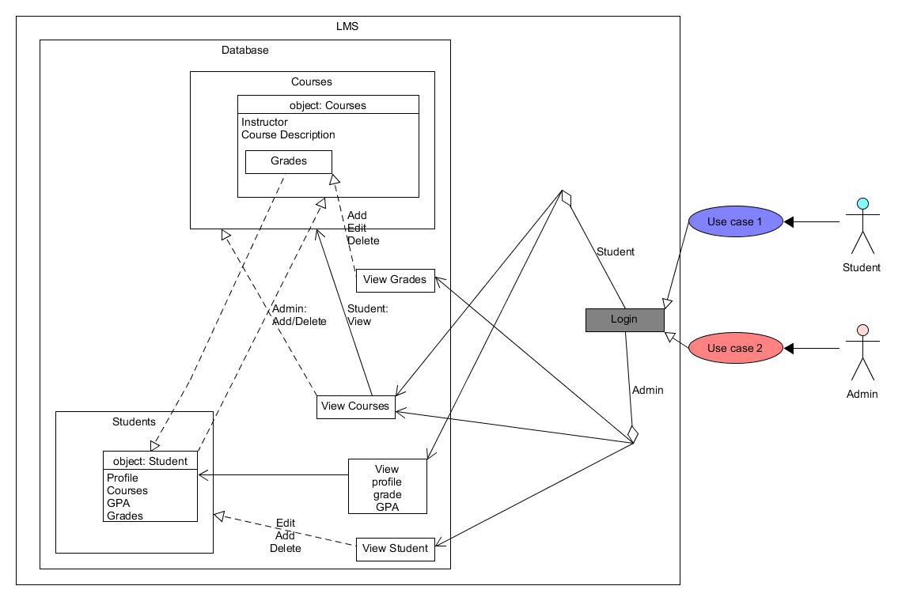
Implementation and Design
The actual module has two distinct log in types, Admin and Student
Student can view their student information, courses, and grades after the Admin has created the record
Student can calculate their GPA
Admin can view, add, and delete Student Info, Courses, and Grades

Slide 8
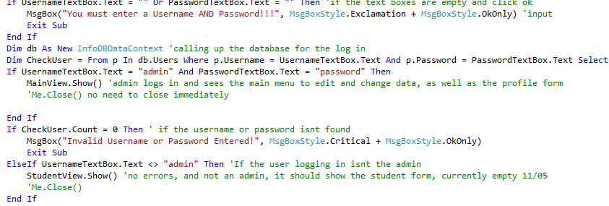
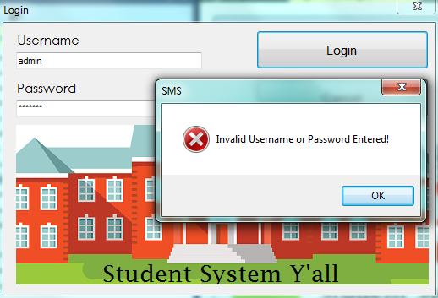
Testing
Code and Fix after every function addition
Admin and Student Logins are the result of testing
Users cannot log in without a correct username and password
User cannot log in to view Admin Hub if the log-in information does not match the admin’s
Users cannot log in or without filling out required forms and fields
Records cannot be added unless it corresponds to a StudentID already in the system
No student record can be created using the same StudentID as an existing student

Slide 9
Software Demo
First the SQL data tables will be shown
Then log in as Student to show empty records, logout
Log in as Admin, view students, add student, delete student
As Admin, view courses, add courses, delete course
As Admin, view grades, add grades, delete grades, logout
Log in as Student, View courses, grades, then calculate GPA

